Slide 1
Breve histórico do estudo de variação
‘Modularidade: Conectando padrões e processos em evolução multivariada’

Slide 2
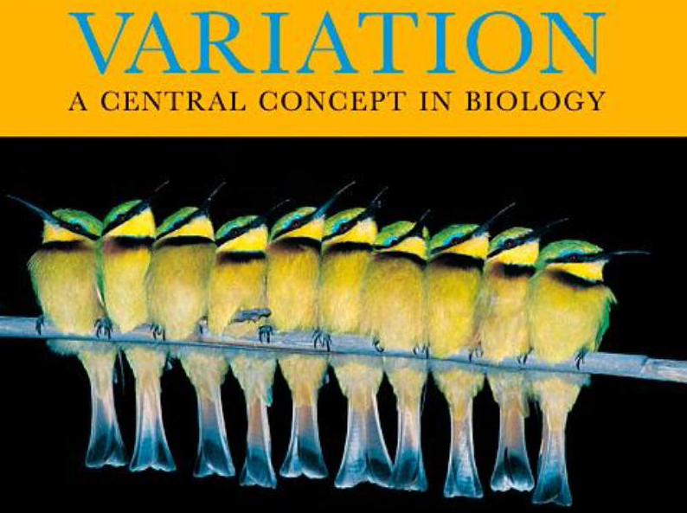

Slide 3
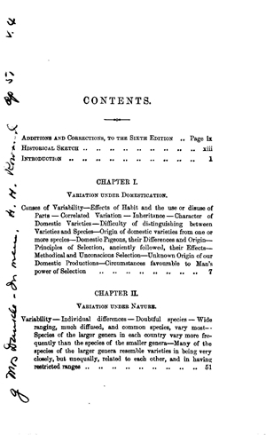
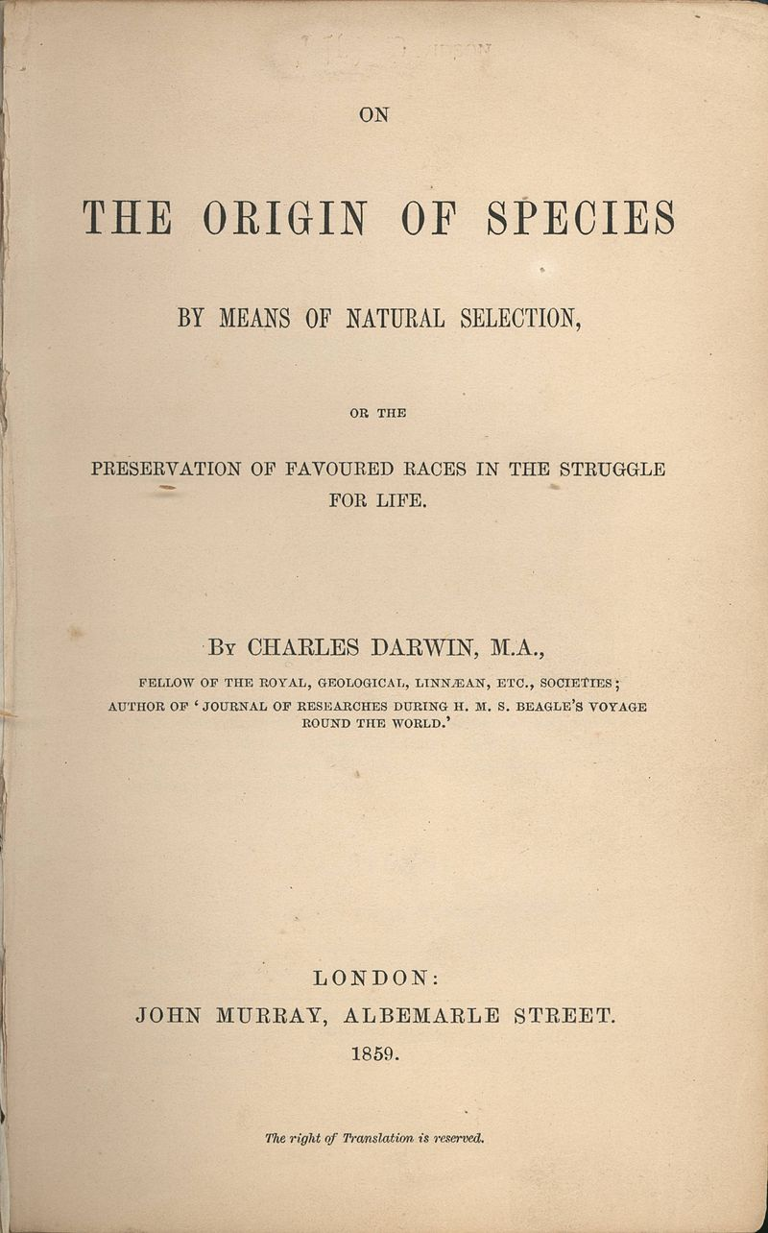

Slide 4
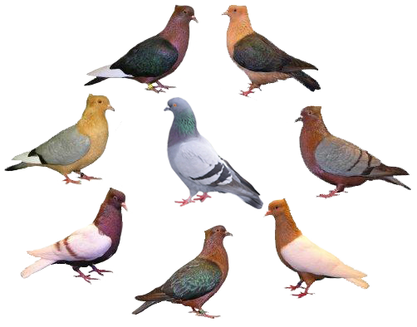
Darwin and Variation
“Great as are the differences between the breeds of pigeons, I am fully convinced that all are descended from the rock pigeon, Columbia livia.”

Slide 5
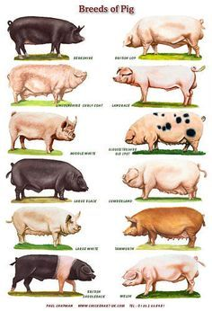
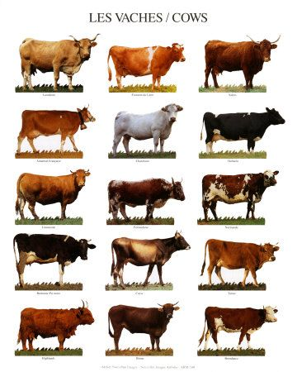

Slide 6
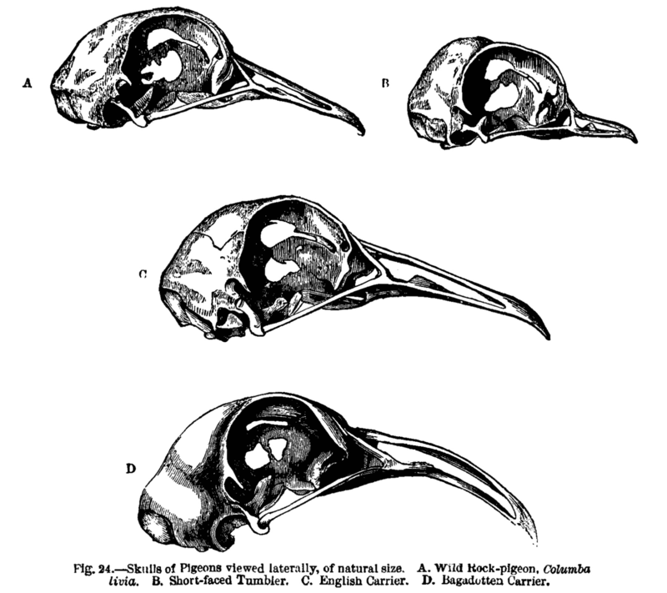
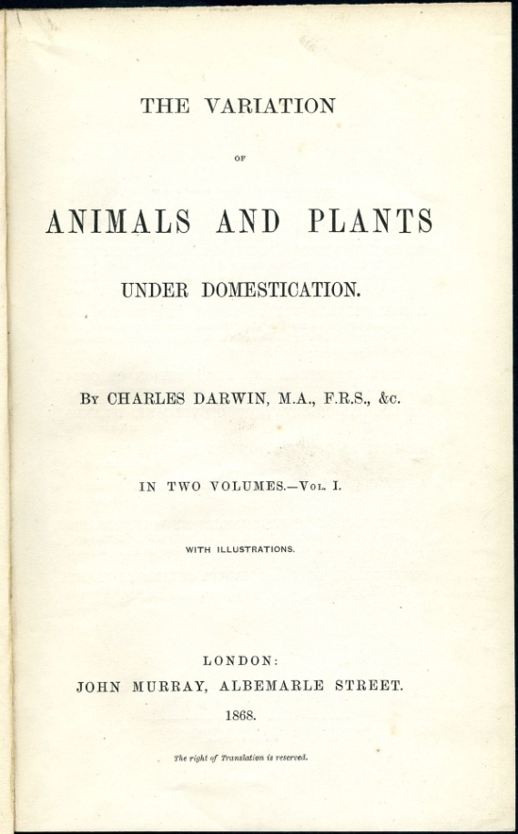

Slide 7
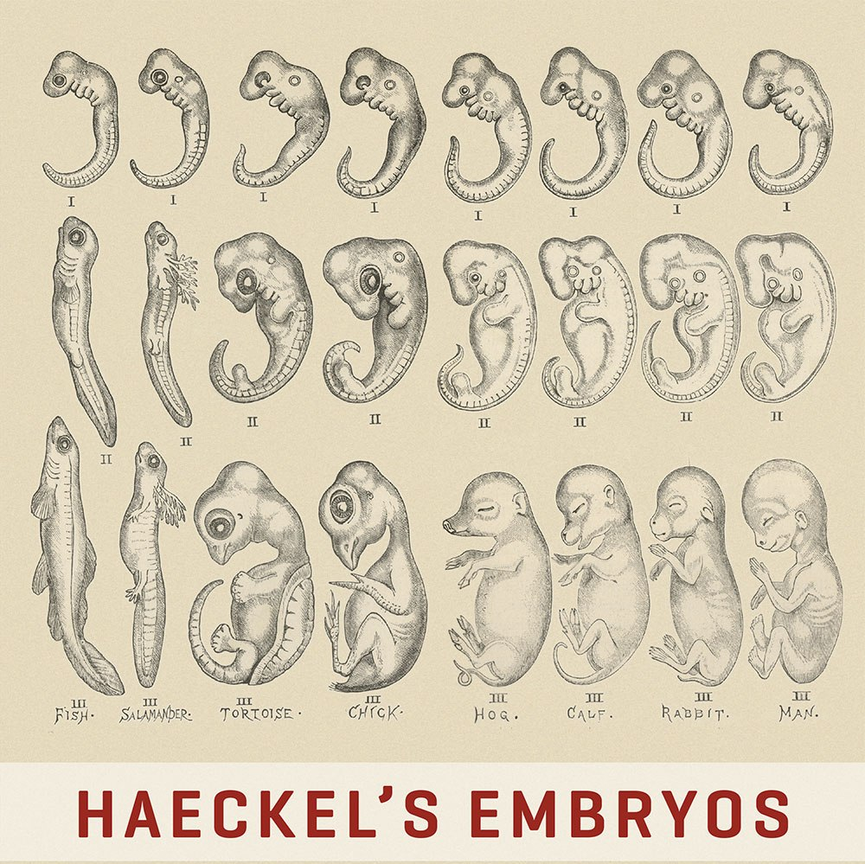

Slide 8
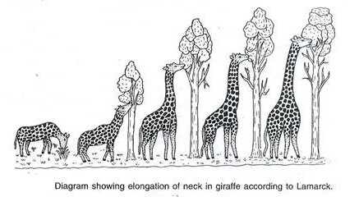
Origin of Variation: use and disuse

Slide 9
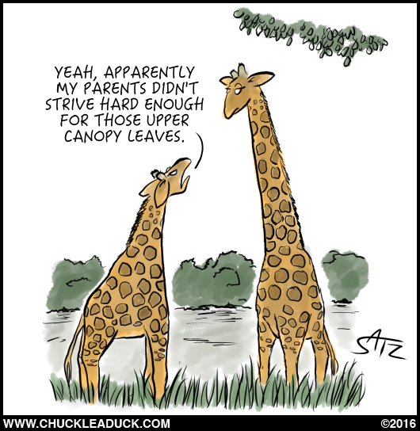

Slide 10
Wallace and Variation
On the Phenomena of Variation and Geographical Distribution as illustrated by the Papilionidæ of the Malayan Region. 1864
“I find as a general rule that the constancy of species is in an inverse ratio to their range. (…) When they extend to many islands, considerable variability appears; and when they have an extensive range over a large part of the Archipelago, the amount of unstable variation is very large”.

Slide 11
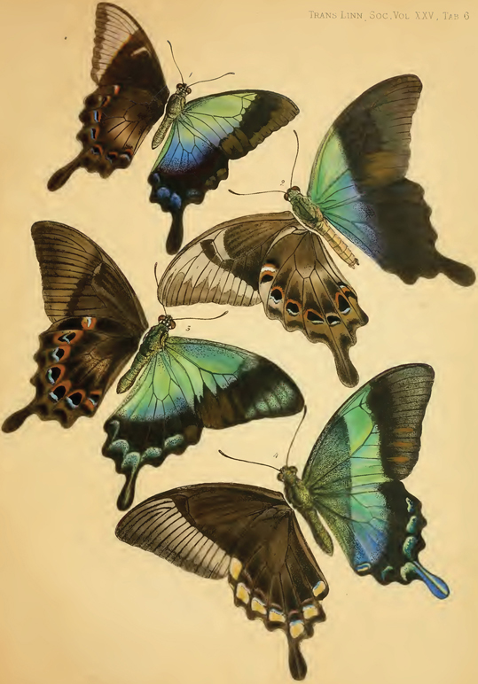
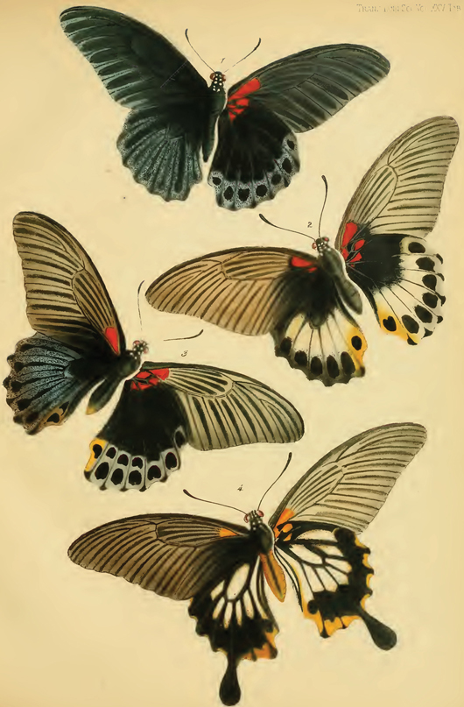
wallace-online.org

Slide 12
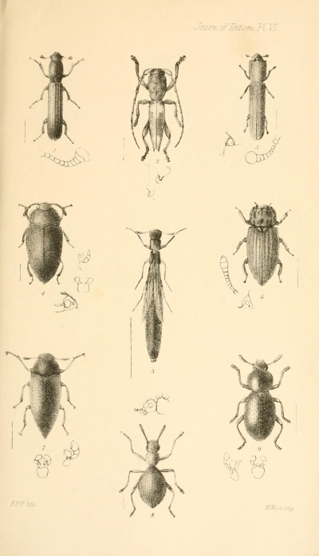
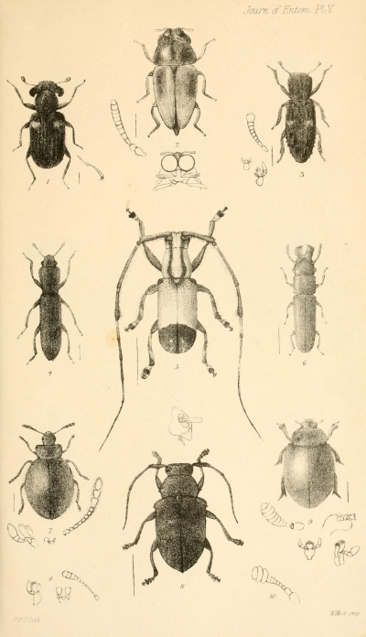

Slide 13
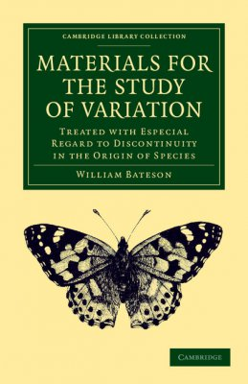
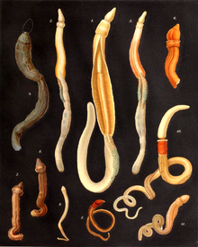
Bateson and Origin of Variation (1890)
Developmental
rearrangements

Slide 14
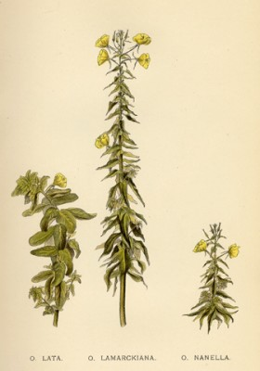
De Vries and Origin of Variation (1894)
Coined the term ‘mutation’ and thought that drastic mutations could lead to new species in a single generation.

Slide 15
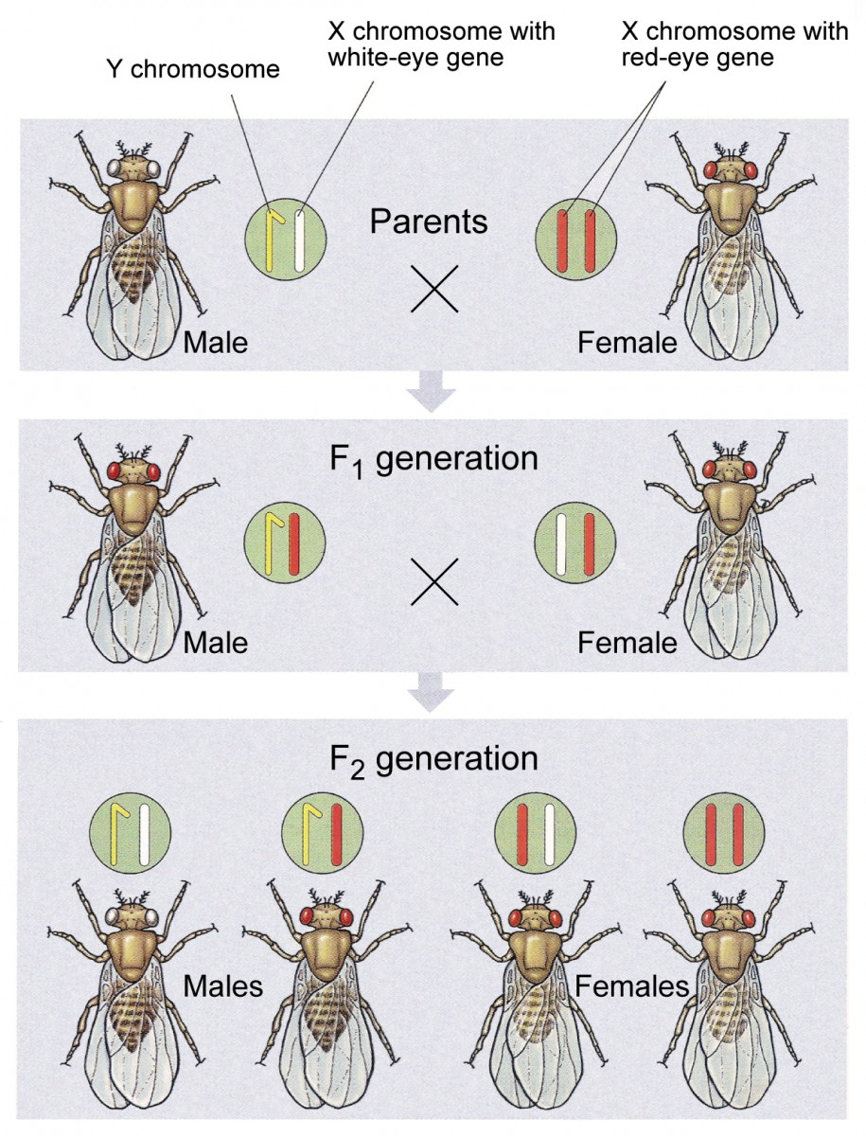
T.H. Morgan and Origin of Variation
X-linked inheritance of eye color in Drosophila: mutation and genes are in chromosomes.

Slide 16
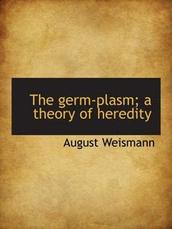
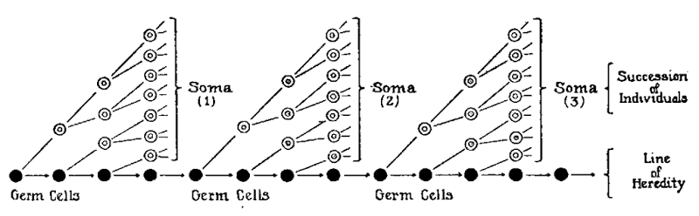
Weisman and Origin of Variation (1893)
No feedback from development to the germ-plasm.

Slide 17
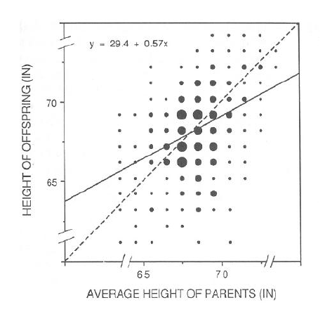
Galton and the Biometricians

Slide 18
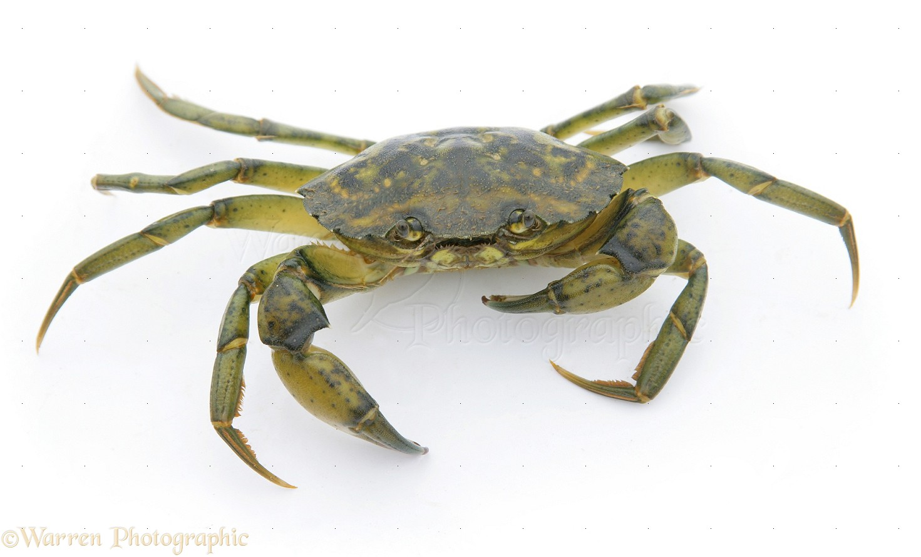
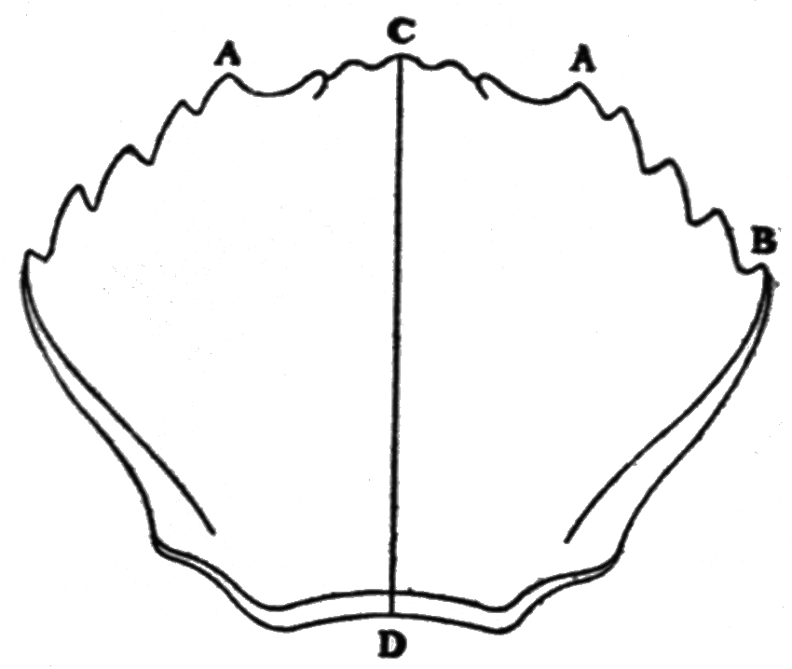
Weldon and Variation in Natural Populations subjected to Selection
" Such selection is, of course, indirect,' that is to say, the life or death of the individual is determined in each case by the value of a (probably large) number of correlated characters, of which the length of the peripheral radius is only one."

Slide 19
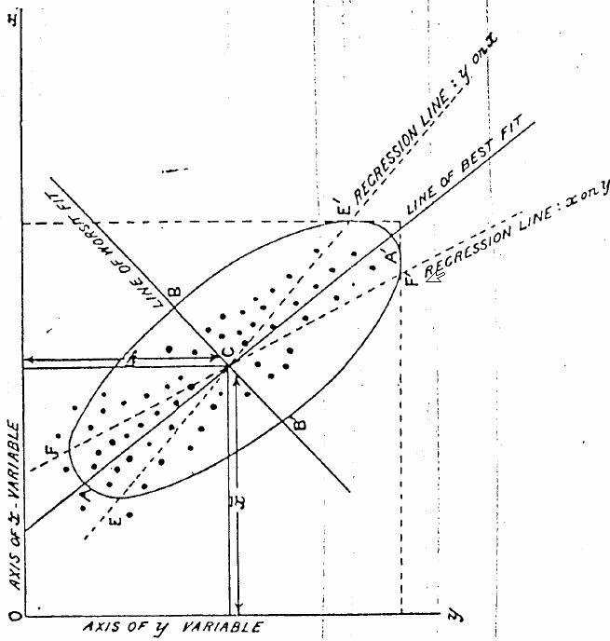
Pearson and statistical thinking in evolution

Slide 20
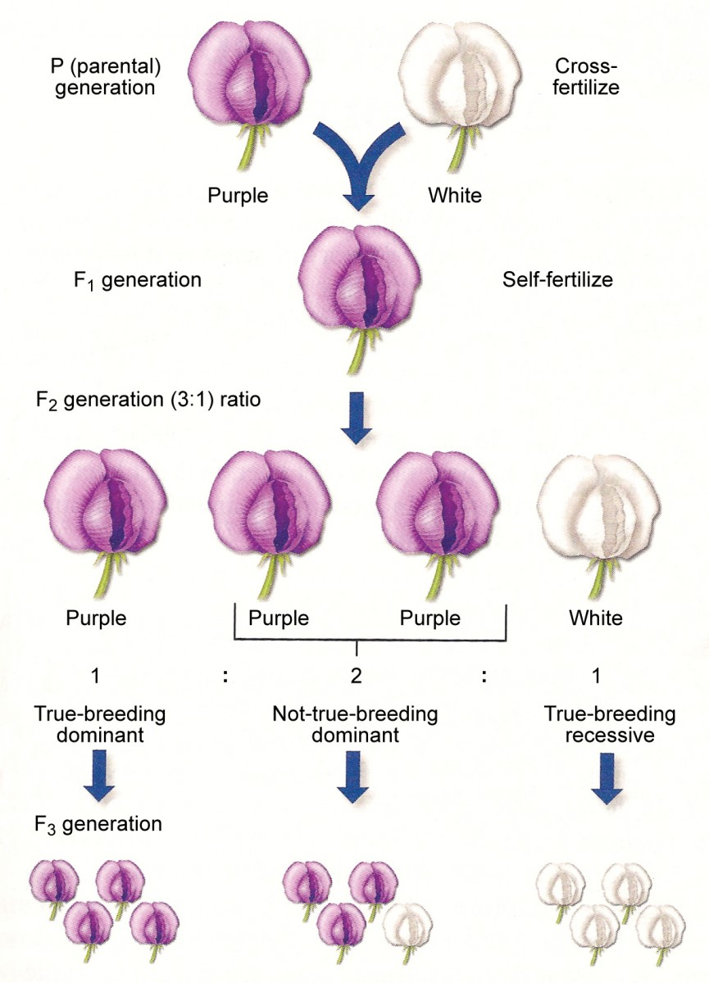
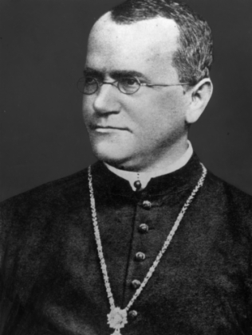
Redescovery of Mendelian Genetics
(1900)

Slide 21
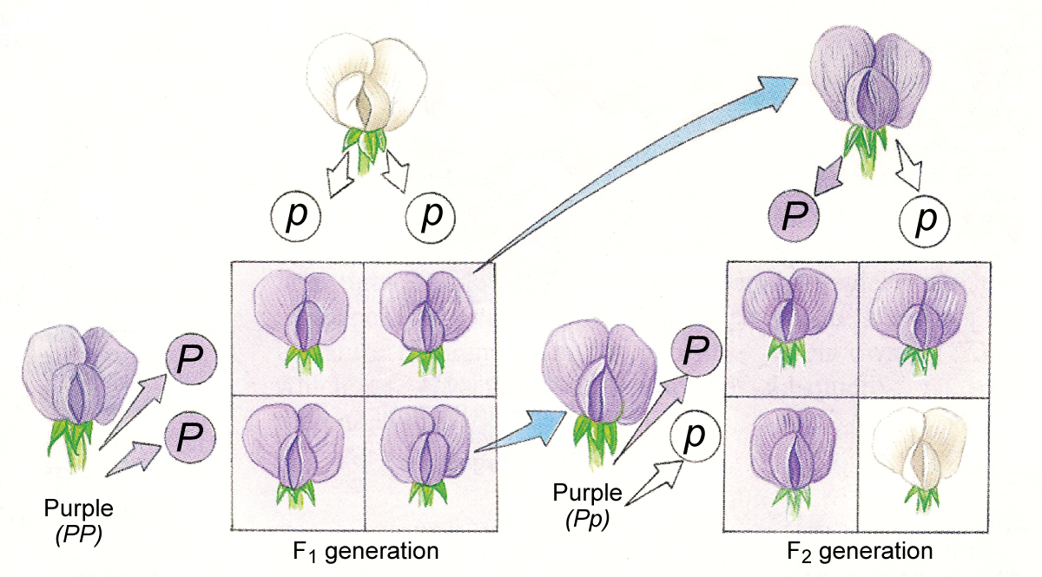
Discontinous variation and Independent segregation

Slide 22
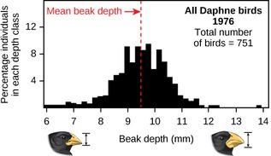
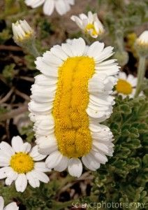
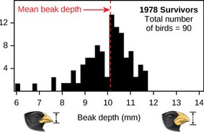
Biometricians X Mendelians or
Selectionists X Mutationists

Slide 23
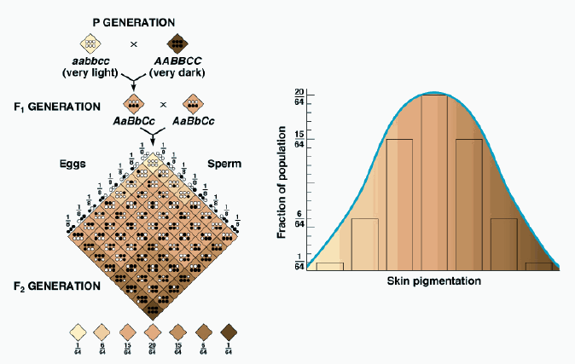
Fisher and Multiple Loci of Small Effect
(1930)

Slide 24
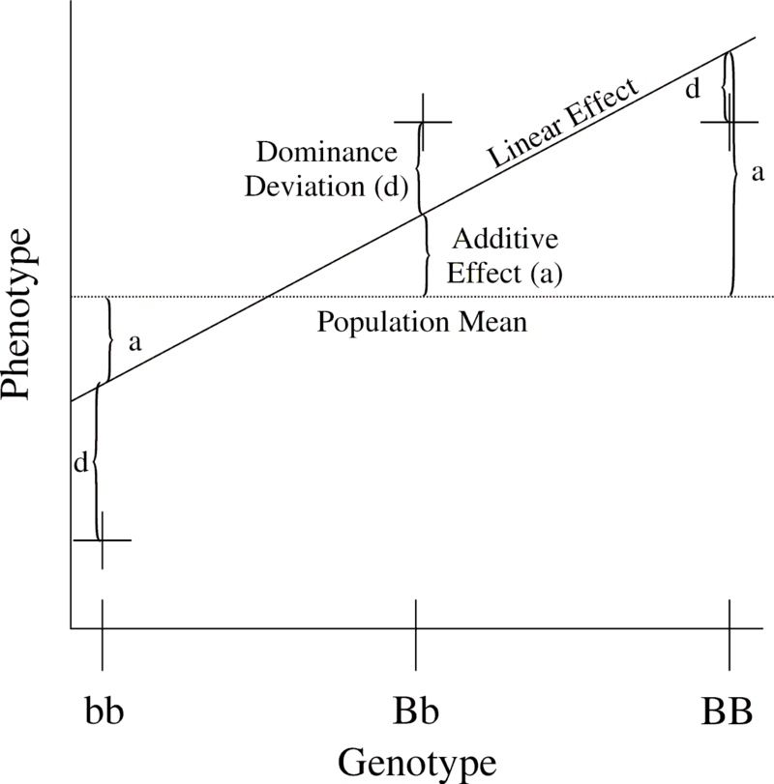
Fisher and Variance Partitioning
VP = VG + VE
VG = VA + VD + VI
Aditive variance
=
Variance in breeding values
=
Sum of allele’s mean effects
=
Heritable variance

Slide 25
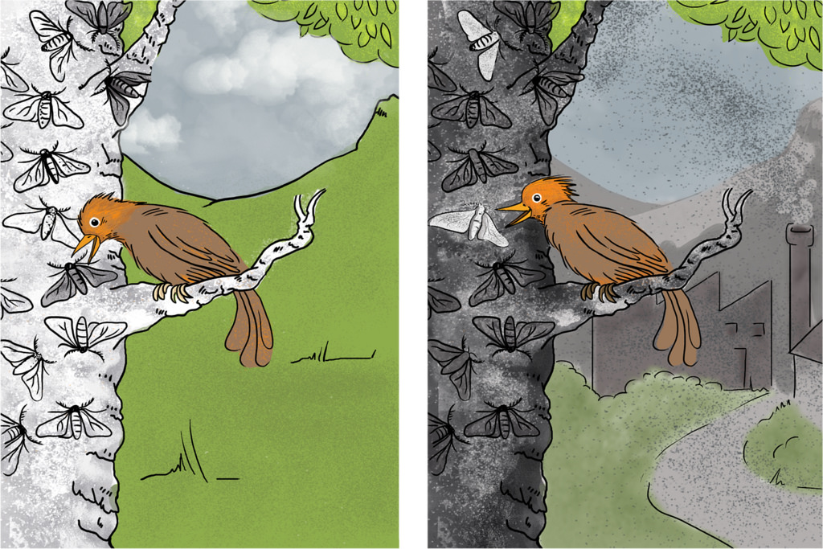
Haldane and the Pepper moths

Slide 26
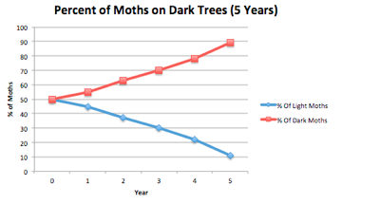
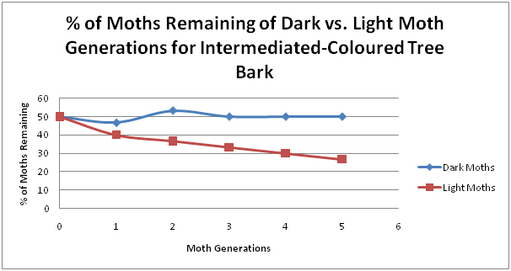
Haldane and Natural Selection

Slide 27
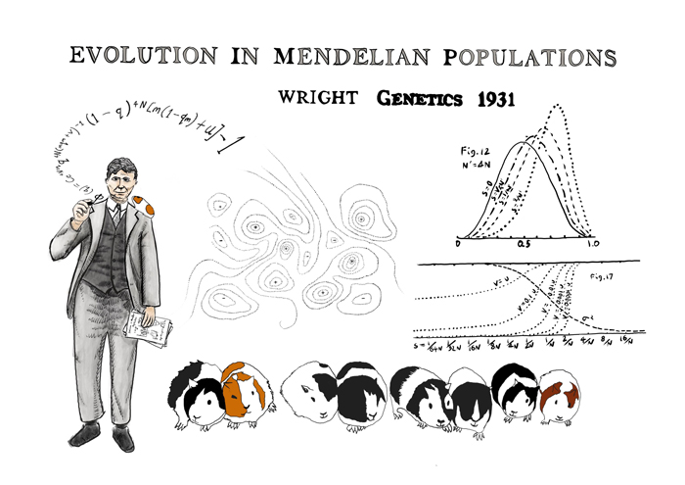

Slide 28
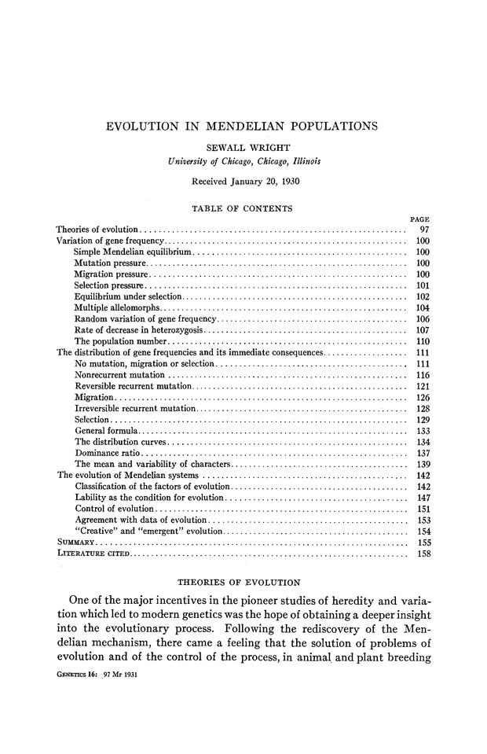

Slide 29
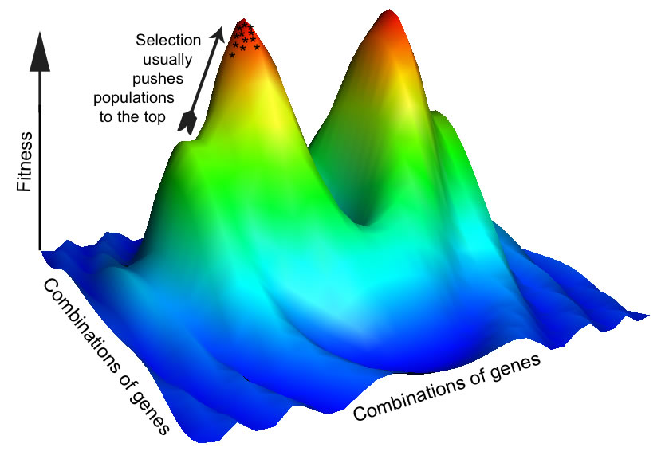
Wright and Epistasis

Slide 30
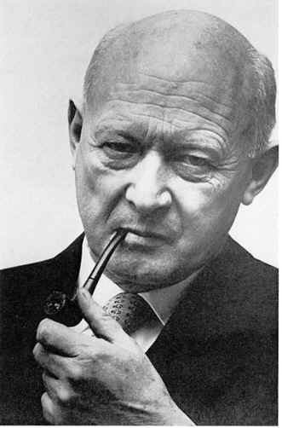
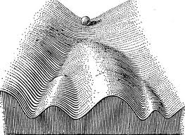
Waddington and the Epigenetic Landscape
(1942)
Canalized developmental pathways

Slide 31
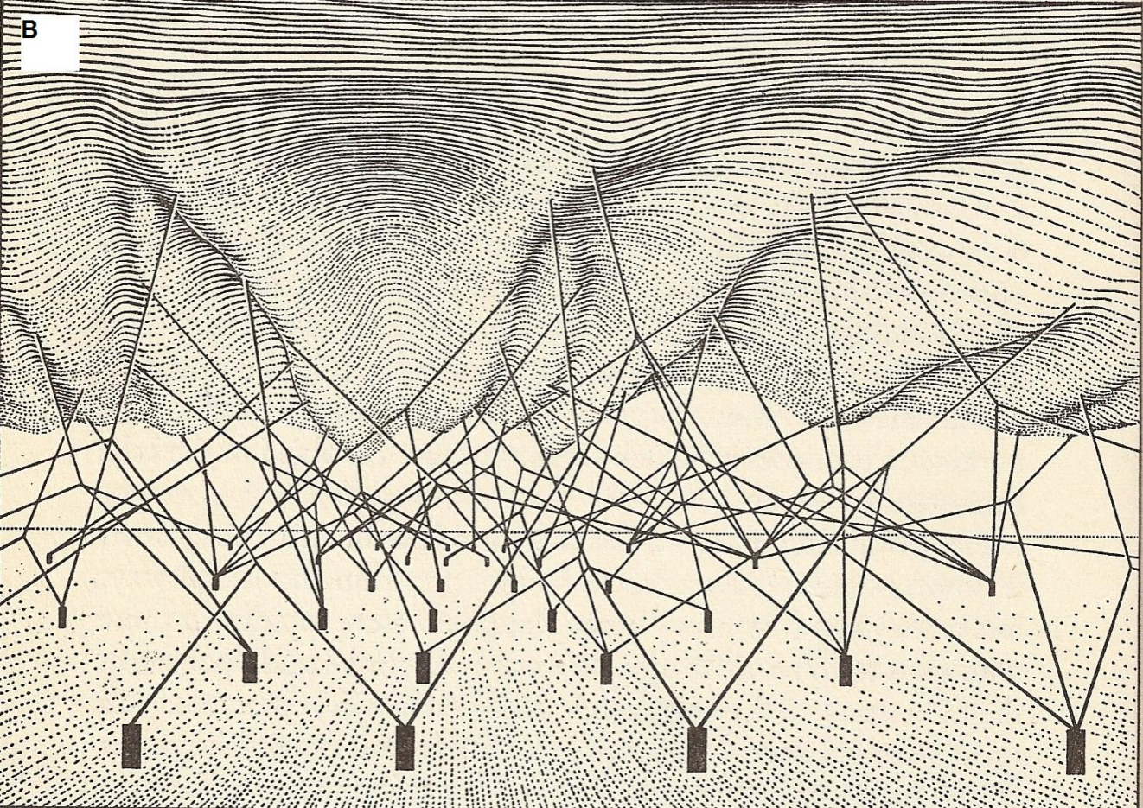
‘... each developmental pathway depends on the interaction of a certain set of genes.’
The Strategy of Genes, 1957

Slide 32
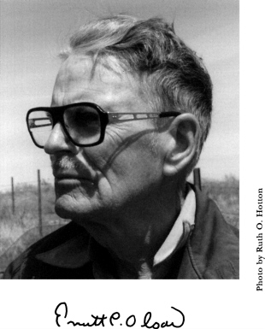
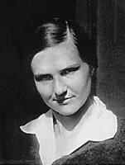
The theory of Morphological Integration/Modularity
(1958, 1960)
Raissa Berg

Slide 33
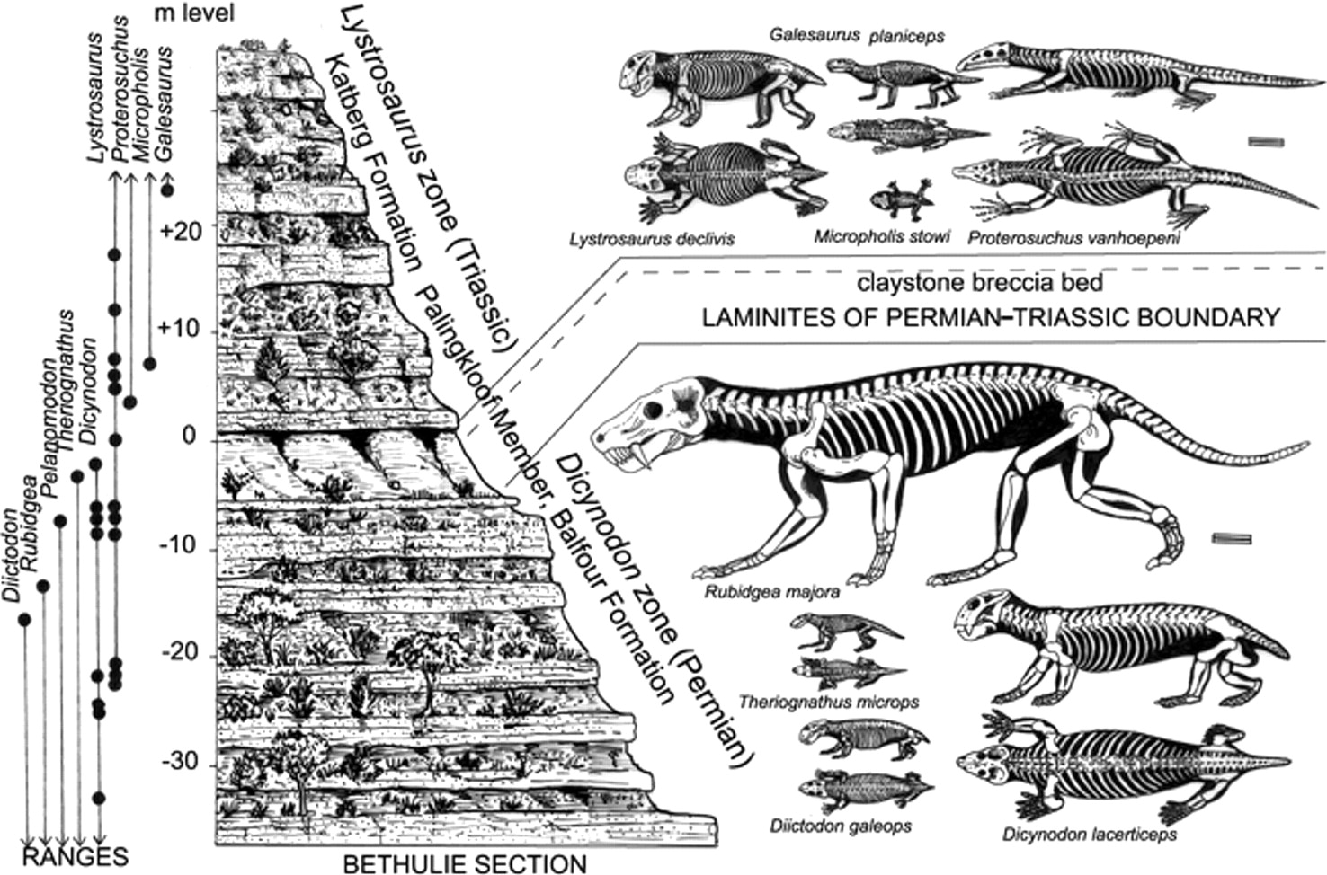
Olson and Vertebrate Paleontology

Slide 34
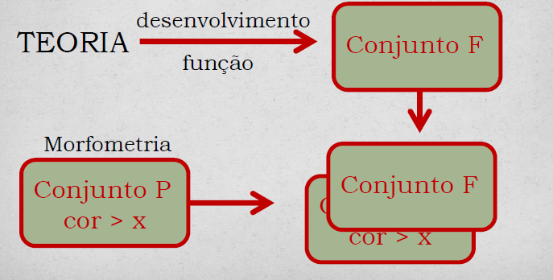
Phenotypic Correlations =
relations among traits
Olsson and Miller (1958)
Development
THEORY
F- set
Function
Morphometrics
P- set
F- set

Slide 35
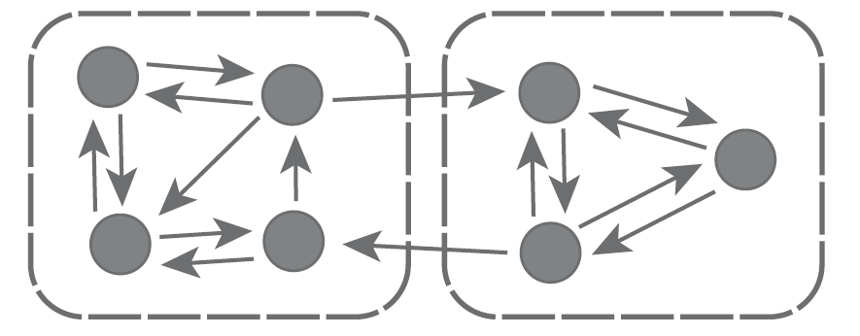
Integration within sets
"It seemed evident . . . that character changes occurring in evolution of species could not be considered to be independent of each other and that studies which did not consider this dependency ignored a significant aspect of change . . ."
(Olson and Miller, 1958).

Slide 36
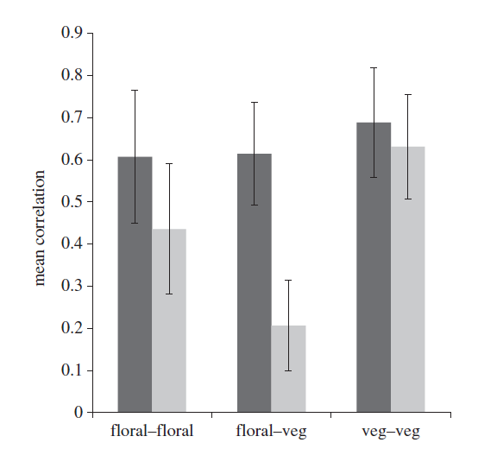
Berg and independence among
Correlation Pleiads
Unspecialized pollinators/wind
Specialized pollinators

Slide 37
Modularity: semi-independence between sets
‘In all the instances of existence of pleiades it was the flower that had become free of the correlation interdependences within the plant organism’.
(Berg 1960)

Slide 38
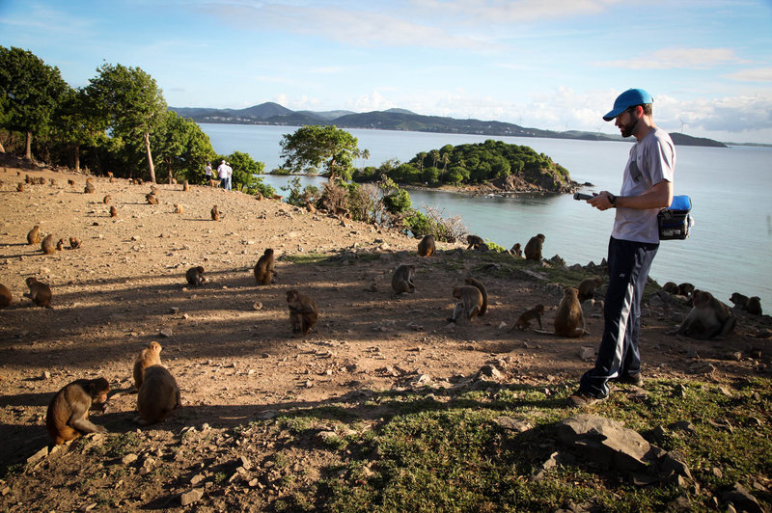
Cheverud 1982: Cayo rhesus macaques
N = 51 mother/offsping pairs

Slide 39
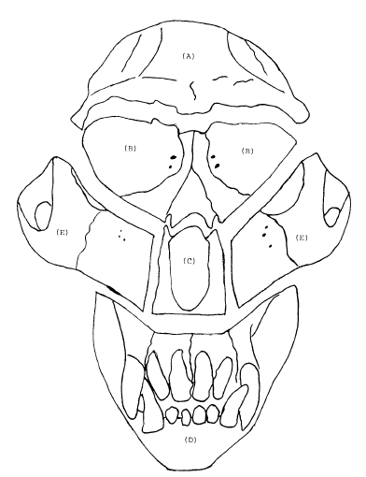
Functional sets
FRONTAL
ORBITAL
MASTICATORY
NASAL
ORAL

Slide 40

‘Individual phenotypic characters and genes only evolve within the larger context of the organism in which they occur. Therefore, the organisms are the integrated functional units which evolve.’

Slide 41



Slide 42




Stabilizing Selection!

Slide 43

Cheverud’s Conjecture (1988)
P = G + E

Slide 44

The Genotype – Phenotype Map
Lewontin 1974

Slide 45

Modular Genotype – Phenotype Map
Wagner 1996

Slide 46

Genotype – Phenotype Map and Integration/Modularity
Porto et al. 2013

Slide 47

Pavlicev et al. (2008):
relationship QTL

Slide 48




